Slide 1
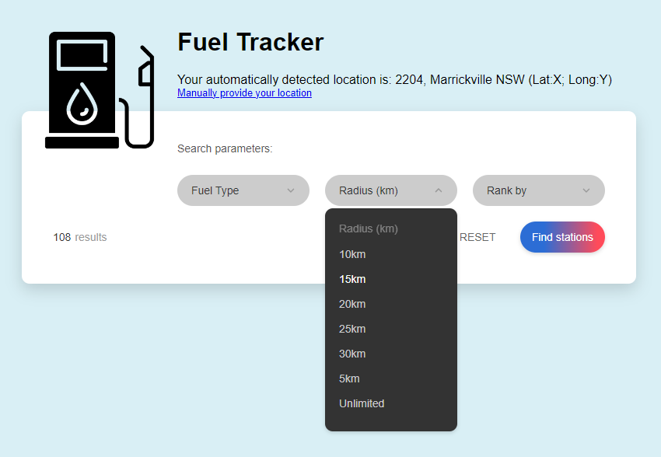
Geo location API
User INPUTS
Brand will be assumed to be all brands
radius
Rank by
Fuel type
Long
Lat
Postcode?
POST
​/FuelPriceCheck​/v2​/fuel​/prices​/nearby
Get fuel prices with in radius
{
"fueltype": "P95",
"brand": [
"BP"
],
"namedlocation": "2065",
"latitude": "-33.4362551",
"longitude": "151.2966549",
"radius": "",
"sortby": "price",
"sortascending": "true"
}
NSW fuel API

Slide 2
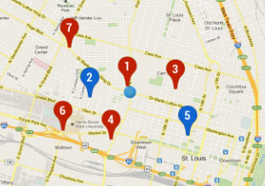
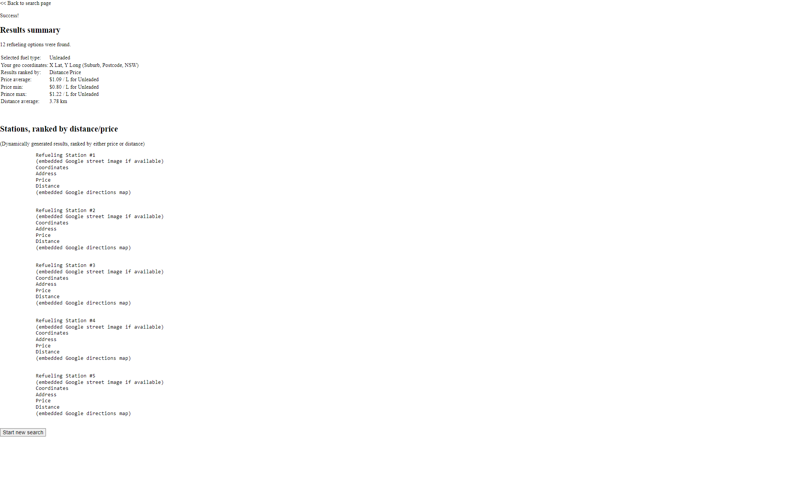
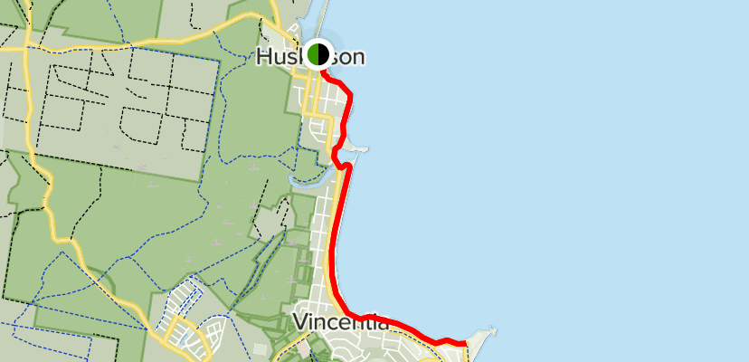
SARAH
It would be nice to get a radius of x km drawn around the device location for the big map
DYLAN

